Slide 1
HYDROCARBON SECTOR IN COLOMBIA AND AN OVERVIEW TO ECOPETROL
Javier Gutiérrez P.
President of Ecopetrol S.A.

Slide 2
DISCLAIMER
This presentation includes future projections related to the probable business development and the Company’s estimated results. Such projections include information related to estimations, approximations or current expectations of the company related to the financial future and its operational results. It should be noted that such information is not guarantee of the performance and that may be modified afterwards. The actual results can fluctuate in relation to the Company’s future projections due to different factor that are out of the issuer control. The Company does not undertake any responsibility for the information herein nor the obligation to review the projections established in this document or to update it, modify it or complement it based on facts happened after its publication.
The information disclosed in this document has an informative and illustrative nature and can not be provided to third parties, nor reproduced , copied, distributed , used or marketed without the Company’s previous authorization and by written.

Slide 3
HYDROCARBON SECTOR IN COLOMBIA
ECOPETROL IN THE LAST YEARS

Slide 4
HYDROCARBON SECTOR IN COLOMBIA
2. ECOPETROL IN THE LAST YEARS

Slide 5
Since the late 90’s, it was expected for 2009 that Colombia would have to import crude and products to meet its internal demand
The exploratory dynamics had been lost, reflected in a dramatic reduction in the drilling of wells A3 and by not accomplishing new reserves findings.
2001 2002 2003 2004 2005 2006
Prod. Property of Ecopetrol
Prod. Corresponding to the royalty of a third party Loads to refinery
Hydrocarbon domestic demand 2004
2009 2010 2011 2012 2013 2014 2015
Prod. corresponding to Ecopetrol royalty Prod. property of shareholders and y third parties net Hydrocarbon domestic demand
Current firm reserves 2004
Source: Ecopetrol 2003

Slide 6
Colombia developed a transformation in the sector that changed its perspective
New Institutional Framework – Decree 1760 from 2003
Objective:
Streamline the public administration organization
Separate the activities of industrial and commercial nature from the ones of administrative nature
Effect:
Ministry of Energy and Mines: Adoption of National Policy
ANH: Hydrocarbon resources administration and promotion
Ecopetrol: Entrepreneurial character
Regulatory and legal framework
Stable and favorable contractual system: All the companies compete under the same terms and conditions.
Modern and profitable E&P contracts: the contractor undertakes all the risks and costs and is the only owner of the production.
Royalties competitive structure: it changed from a fix percentage of 20% to a variable one according to the production volume.
Tax incentives: legal tax rate of 33% and deduction of 40% of the investment made for the tangible fix assets acquisition.
Government –Industry agreement
Incentive to the private investment

Slide 7
The market opening allowed the growth in the contracts’ signing
Up to date the ANH has performed 7 rounds
*/ 2010: For the Colombia 2010 round, 78 blocks were assigned. The signing of these contracts is: 68 contracts E&P and 10 contracts TEA.

Slide 8
We went from 12,5 million hectares assigned to 102 million hectares in 8 years
AREA ASSIGNED IN COLMBIA
Colombia has 164 million hectares. In the Colombia 2012 round, 109 blocks will be assigned (98 onshore and 11 offshore), which represent 13,5 million ha (8% in contracted area).

Slide 9
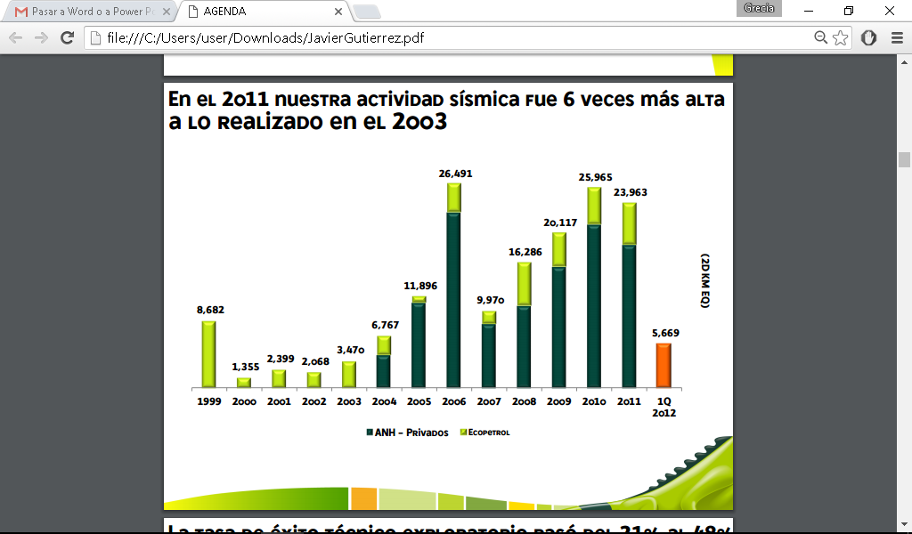
In 2011, our seismic activity was 6 times higher than in 2003
Private

Slide 10
The exploratory technical success rate went from 21% to 48% and the wells have increased 4 times in 8 years.
Producer
I n Test
Dry - FE
« Even though the success rate registered in 2011 in the Colombian exploratory wells were lower than the two years prior, the reality is that it continues in historically high levels, and even, with the plans that are being anticipated by the oil companies, it could be higher in 2012”. Portafolio -Newspaper January 23rd, 2012.

Slide 11
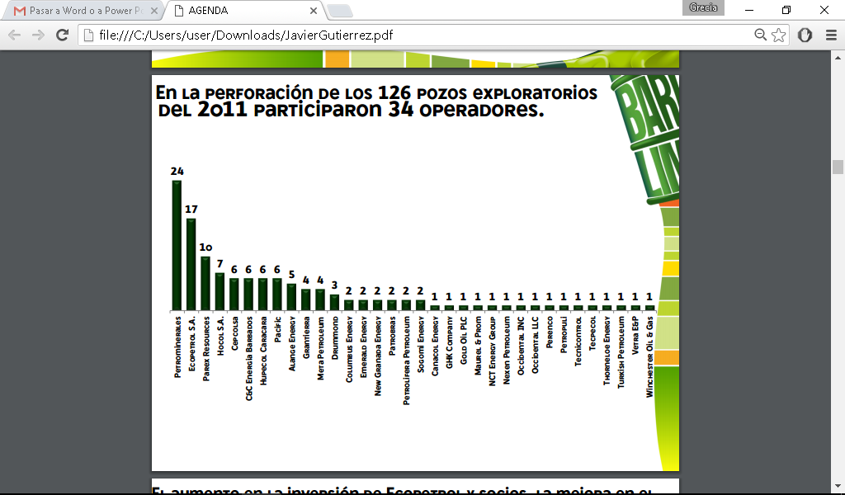
34 operators participated in the drilling of 126 exploratory wells in 2011.

Slide 12
The increase in the Ecopetrol and partners investment, the improvement in the recovery factor and the increase of the exploratory activity has generated a sustainable improvement in the country’s production.
Crude

Slide 13
51 companies contributed In the 2011 hydrocarbons production acquisition
The Ecopetrol and the Metapetroleum production represent 57% of Colombian total production.

Slide 14
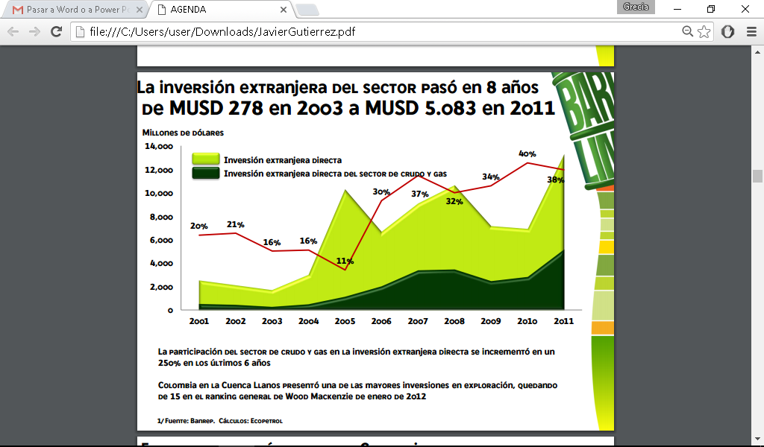
The sector foreign investment went in 8 years from MUSD 278 in 2003 to MUSD 5.083 IN 2011.
Million dollars
Direct foreign investment
Crude and gas sector Direct foreign investment
The crude and gas sector participation in the direct foreign investment increased in 25% in the last 6 years.
Colombia in Llanos Basin represented one of the biggest investments in exploration, being number 15 of the Wood Mackenzie general ranking of January 2012.
1/ Source: Banrep. Calculation: Ecopetrol

Slide 15
The oil and gas sector in Colombia has shown growth rates higher than 14% in the last 4 years
Sector Growth
1/ Source: DANE. Constant base prices 2009. *Calculation: Ecopetrol

Slide 16
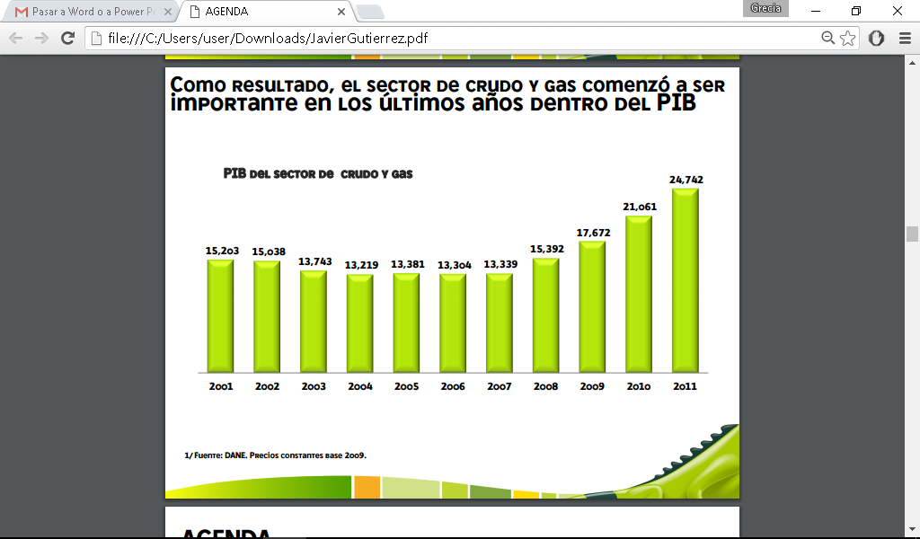
As a result, the crude and gas sector started to be important in the last year within the GDP
Crude and gas sector GDP
1/ Source: DANE. Constant base prices 2009.

Slide 17
1. HYDROCARBON SECTOR IN COLOMBIA
2. ECOPETROL IN THE LAST YEARS

Slide 18
As Colombia developed a transformation, Ecopetrol also had important changes
2003 – Decree 1760
Public Company by Shares with the structure of a Limited Company.
Dedicated to industrial and commercial activity.
Keeps in Ecopetrol S.A. the administration of partnership contracts, the direct operation areas and the production of both.
It was established that Ecopetrol would be:
From the team of public companies.
Another player in the industry.
2004 and 2005
Internal Transformation Process:
Business Management System
1st Code of Good Government
Operational Excellency
Strategic Review

Slide 19
As Colombia developed a transformation, Ecopetrol also had important changes
2006 - Law 1118
It is the completion of the Process initiated by the Decree Law 1760 of 2003.
Ecopetrol is consolidated as a limited company, independent from the national budget, subject to the private laws regulations and with possibilities of incorporating to its assets private capital up to a maximum of 20%.
Ecopetrol was established to be the team of the mixed companies Implementation of corporate governance standards
Ecopetrol internationalization with the creation of a subsidiary in Brazil
2007
Mixed Economy Company
The CBG is updated according to the standards for shares issuers
First shares issue: BUSD 2.8 (10.1%)
BVC Stock Exchange Price
New Corporate Image

Slide 20
As Colombia developed a transformation, Ecopetrol also had important changes
2008
ADRs lists in the New York Stock Exchange
Acquisition of Propilco, Ecopetrol Peru and Ecopetrol América
Ecopetrol declares itself as Business Group
2009
Wage competitiveness
Lists in the Lima Stock Exchange
Acquisition of Hocol, Grupo OIG, Ocensa and Reficar
2010
Lists in the Toronto Stock Exchange
Acquisition of BP Colombia (today Equion)

Slide 21
As Colombia developed a transformation, Ecopetrol also had important changes
2011 - Second shares issuance
Shareholder Structure
(Dic 31-11)
Offer
Award Results
COL$2,38
trillions
507 thousand shareholders
Natural Persons
Institutionals
Rep. Colombia ADRS
Other Instit.
Instit. Invest. (Colombia)
Natural Persons Foreign Invest. In shares

Slide 22
Ecopetrol by the end of last year updated its strategic framework and its investment plan
Mission:
We find and convert energy sources in value for our clients and shareholders ensuring the people’s integrity, the processes’ security and the environment care, contributing to the well-being of the areas where we operate, with a committed staff that seeks excellence, its comprehensive development and the long term relationship building with our stakeholders groups.
Vision 2020:
Ecopetrol, Business Group, focused in oil, gas, petrochemistry and alternative fuels, will be one of the 30 main companies of the oil industry recognized for its international positioning, its innovation and commitment with the sustainable development.
Note 1: Within the 2012 PIW Ranking of the World Oil Companies Ecopetrol ranks 48

Slide 23
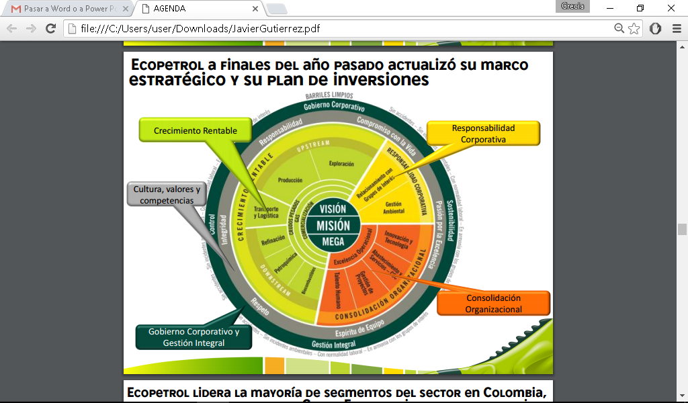
¿
Ecopetrol by the end of last year updated its strategic framework and its investment plan
Profitable Growth
Corporate Responsibility
Culture, values and competences
VISION MISION MEGA
Organizational Consolidation
Corporate Government and Comprehensive Management

Slide 24
Ecopetrol leads most of the sector segments in Colombia, it has been established as a Business Group with a diversified portfolio and international presence
Refining and Petrochemistry:
Transport:
Biofuel:

Slide 25
Ecopetrol will invest in the development of the whole chain close to USD 80 trillion 2012 -2020
BUSINESS | CAPEX (BUSD) 2012-2020 | %
Upstream | 69 | 87
Downstream | 6,5 | 8,5
Midstream | 4 | 5,0
Competitive advantage in Heavy Crudes
Increase of the recovery factor
Exploration in proven basins and border
Offshore Exploration
Gas and HNC development
Technologies incorporation
of investment In Colombia
Transport and Logistics
Company’s growing lever
Service scheme for the business group and third parties
Technology incorporation
Value addition to the heavy crudes
Greater capacity of heavy crudes processing
Valuable and clean fuels (↓ sulphur)
Market consolidation and development
Investment consolidation and biofuels research
Exploration Refining
Production Transport

Slide 26
Our growth plan is established MEGAS to 2020: this is the investment development framework
Reserves Incorporation 1P 2011 - 2.020* 6.200 MBPE
Production 2.020*
ROCE
1.3 MBPED
28%
Being between the leaders in refining in Latin America
Biofuel 2.020
Gas national sales 1.000 GBTUD
ROCE
2.020 – 2.025
Refining
Petrochemistry
Midstream business as a benefit center for the Oil sector
Transport capacity: 1.7 million barrels per day
* Includes royalties

Slide 27
We have increased our investments in the middle of a difficult environment
Acquisitions and contributions to subsidiaries
Millions of dollars
Exploration
Production
Refining and Petroq.
Transport Corporate/others

Slide 28
We have increased well drilling and its exploratory success
Drilled wells
International
National
Successful
Exploratory success
In 2011, we drilled 9 stratigraphic wells from which 5 shown hydrocarbons

Slide 29
Our production growth is one of the highest in the industry: 16% year average
Historical results
Thousands of equivalent oil barrels

Slide 30
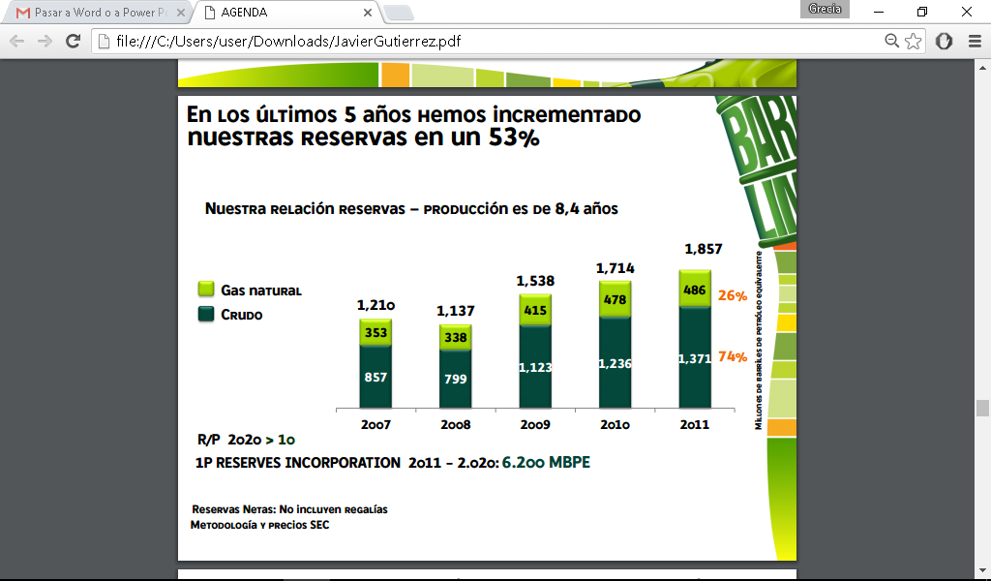
In the last 5 years, we have increased our reserves in a 53%
Our relation reserves – production is 8,4 years
1,857
Millions of equivalent oil barrels
Natural Gas
Crude
R/P 2020 > 10
1P RESERVES INCORPORATION 2011 - 2.020: 6.200 MBPE
Net reserve: Does not include royalties
SEC methodology and prices

Slide 31
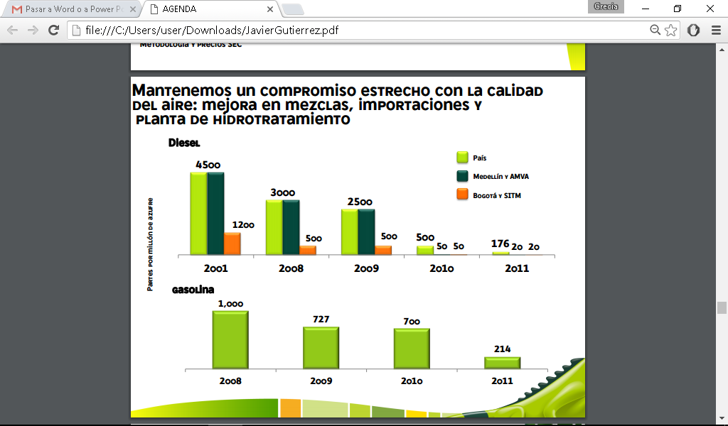
We keep a close commitment with the air quality: improvement in mixtures, imports and hydro treatment plant
Country
Medellín y AMVA
Bogota and SITM
Gasoline

Slide 32
We have increased our mobilization of crude and refined barrels up to 1.2 millions
Crudes
Thousands of barrels/day
Products

Slide 33
Our sales grew a 14% average in the last 4 years and the exports in a 35%
Exports
*Includes free zone
Local sales
Thousands of barrels/day

Slide 34
Our organizational consolidation continues levering the growth
Reduction of environmental accidents and incidents
Emissions reduction
Declaration of the majority shareholder
Clear dividend policy
Good Government Code
CORPORATE GOVERNMENT
Competitive wages and variable remuneration
Leadership development program
Trust agreement with unions
HUMAN TALENT
CORPORATE RESPONSIBILITY
Commitment with our stakeholder groups
Sustainability report
Social investment and support to projects
COMPREHENSIVE MANAGEMENT
Comprehensive management by processes
Internal control system: SOX, COSO, COBIT
Technological development

Slide 35
Ecopetrol is committed with the Corporate Government practices
• It is the best way to promote and guarantee the rights of our interest publics.
• Generates trust as a key element to create economic value.
• Builds a transparency environment, internal and externally, that generates trust to the different Stakeholder Groups.
• Facilitates the access to the capital markets to access to sources of funding in better terms.
• Strengthens the reputation inside and outside the organization.
• A basic condition for the company sustainability.
TRANSPARENCY
GOBERNABILITY
TRUST IN OUR STAKEHOLDER GROUPS
COMPREHENSIVE MANAGEMENT SYSTEM
ETHICS
CONTROL AND PRVENTION SYSTEM

Slide 36
Our good government code compiles the best practices that generate trust in the stakeholder groups and in the market in general
Rights and equal treatment to the shareholders
Shareholders General Assembly
Board of Directors
Chief executive and other executives
Corporate Social Responsibility
Transparency, fluency and integrity of the communication and information
Control
Conflict of interest
Mechanisms of disputes resolution
Securities negotiation

Slide 37
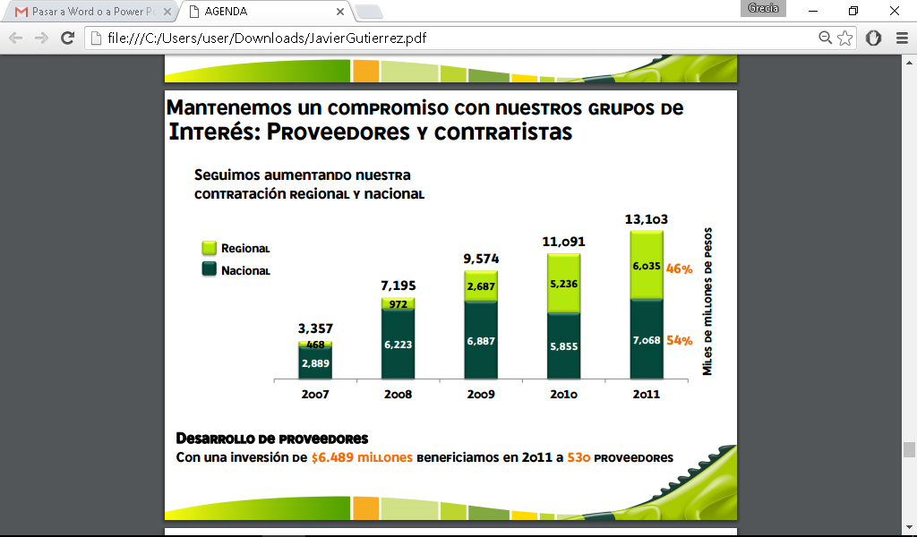
We keep a commitment with our stakeholder groups: Providers and contractors
We continue increasing our regional and national recruitment
Billions of pesos
Regional National
Providers Development
With an investment of $6.489 millions we benefit in 2011 to 530 providers

Slide 38
We keep a commitment with our stakeholder groups: Society and community
We have increased the social investment in a 35%
Millions of pesos
Investment lines:
Education and Culture $54.413 millions
Regional Competitiveness $124.300 millions
Citizenship and Democracy $35.410 millions

Slide 39
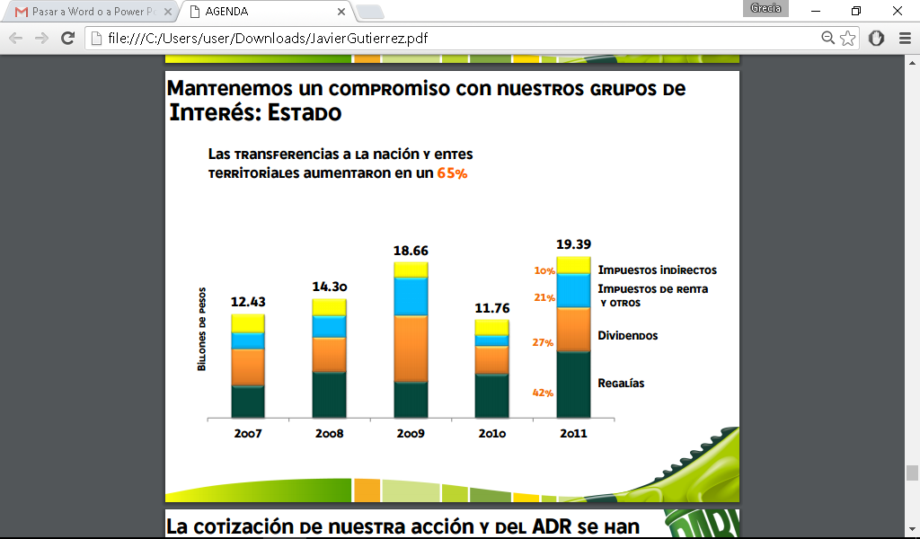
We keep a commitment with our stakeholder groups: State
The transfers to the nation and territorial entities increased in a 65%
Indirect taxes
Income taxes and others
Trillions pesos
Dividends
Royalties

Slide 40
The quotation of our share and the ADR have been valued in attractive rates
SHARE

Slide 41
In 2011, we became part of the Down Jones Sustainability Index – World DJSI
Ecopetrol Average
Economic
Environmental
Social
We are one of the 12 companies of O&G in the sustainability index and one of the 4 Colombian ones.

Slide 42
HOW WE WANT TO BE RECOGNIZED!!
clean barrels
NO
ACCIDENTS
ENVIRONMENTAL INCIDENTS LABOR REGULATIONS
HARMONY WITH THE STAKEHOLDER GROUPS
NO
WITH
IN
and sustainable
THREE DIMENSIONS: ECONOMIC, ENVIRONMENTAL AND SOCIAL
IN

Slide 43
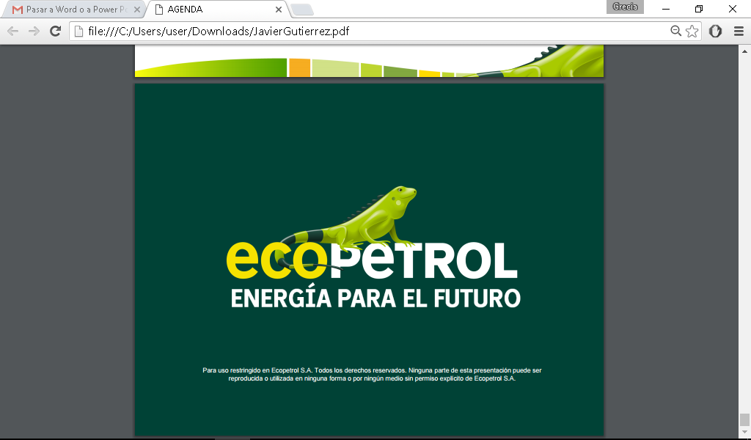
ENERGY FOR THE FUTURE
For restricted use in Ecopetrol S.A. All rights reserved. No part of this presentation can be reproduced or used in any way or by any means without explicit permission of Ecopetrol S.A.

